Slide 1

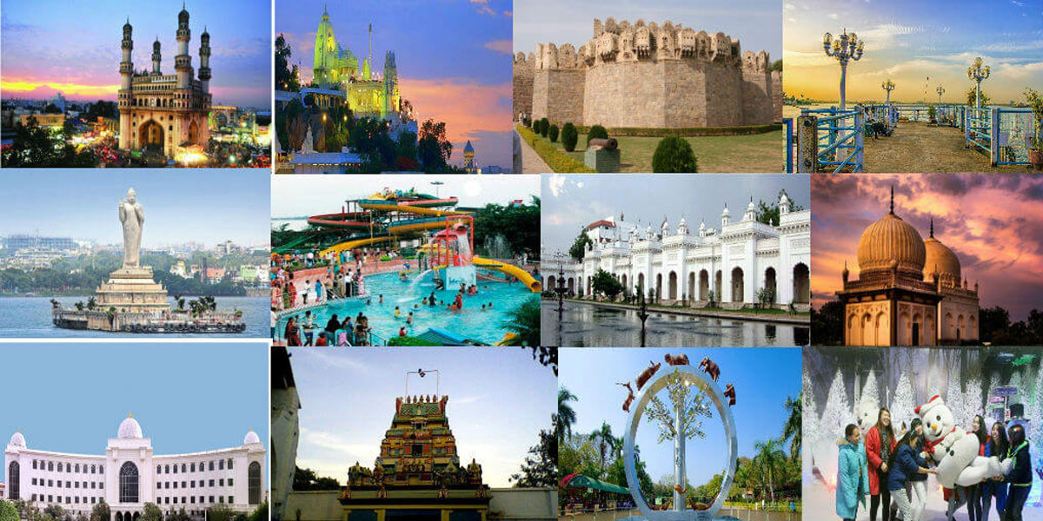
Telangana Tourism Analysis
Presented by
Yashwanth Marrapu

Slide 2
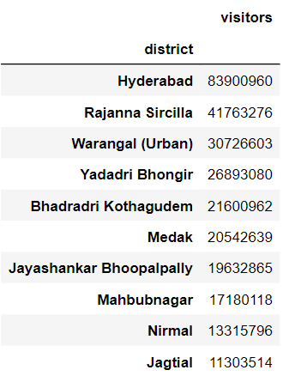
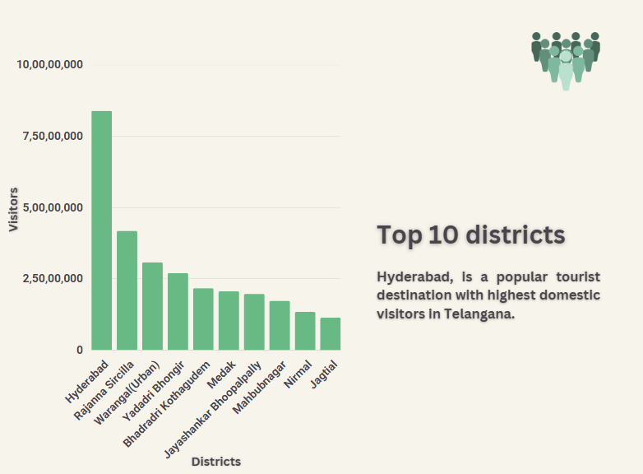
Top 10 districts with the highest number of domestic visitors (2016-2019)

Slide 3
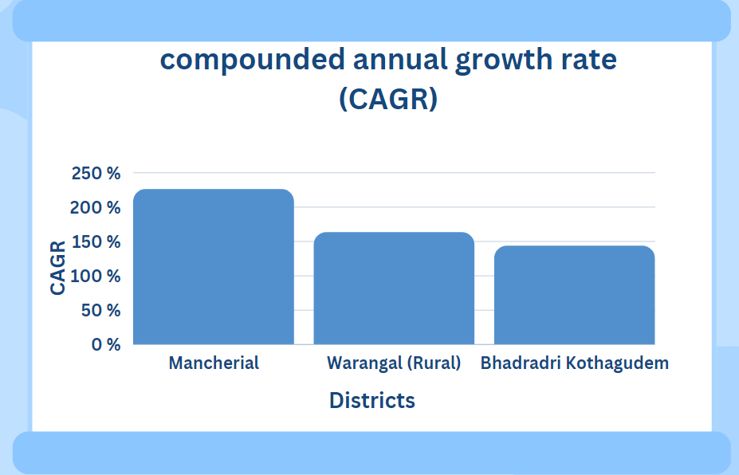
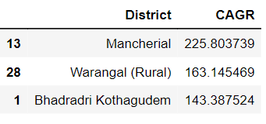
Top 3 districts based on compounded annual growth rate(CAGR) (2016 - 2019)

Slide 4
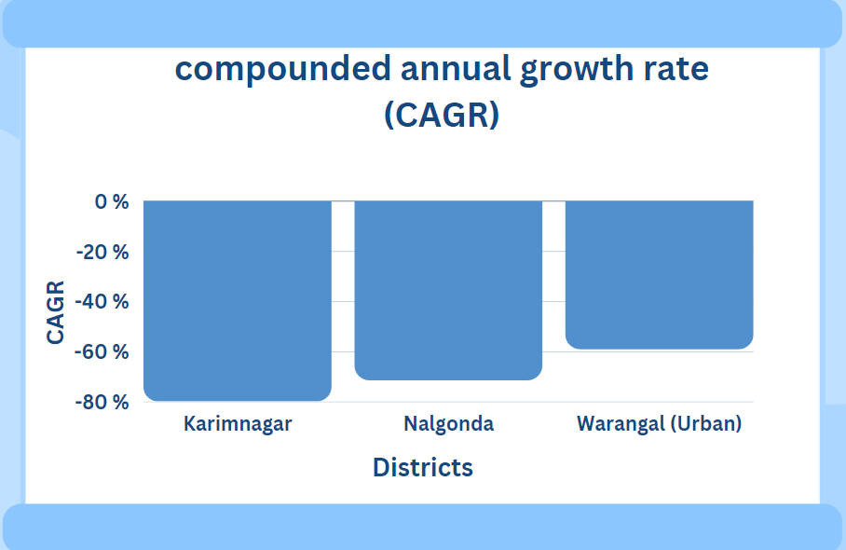
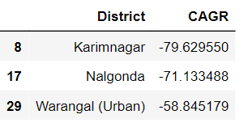
Bottom 3 districts based on compounded annual growth rate(CAGR) (2016 -2019)

Slide 5
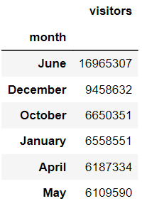
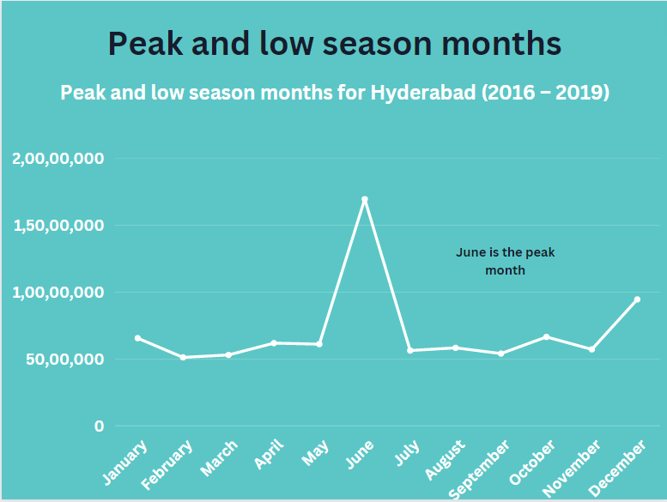
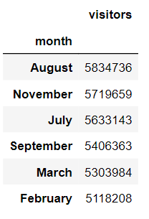
Peak and low season months for Hyderabad (2016 – 2019)

Slide 6
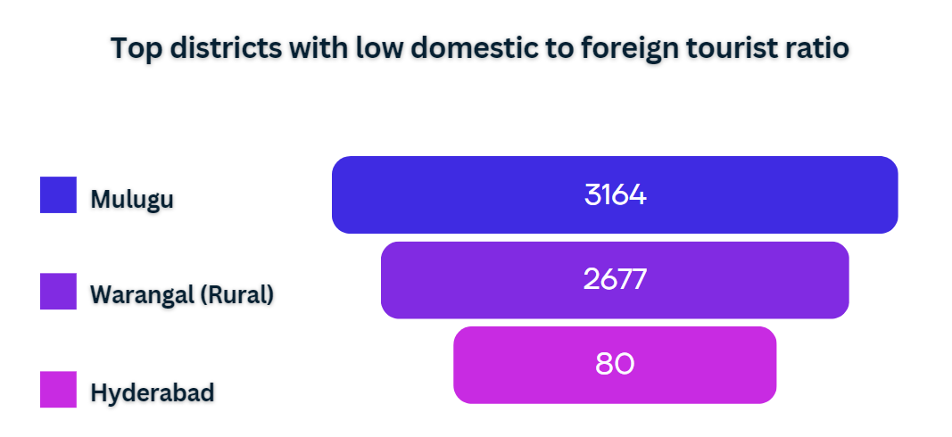
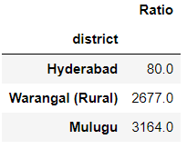
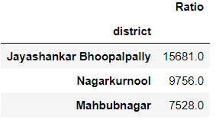
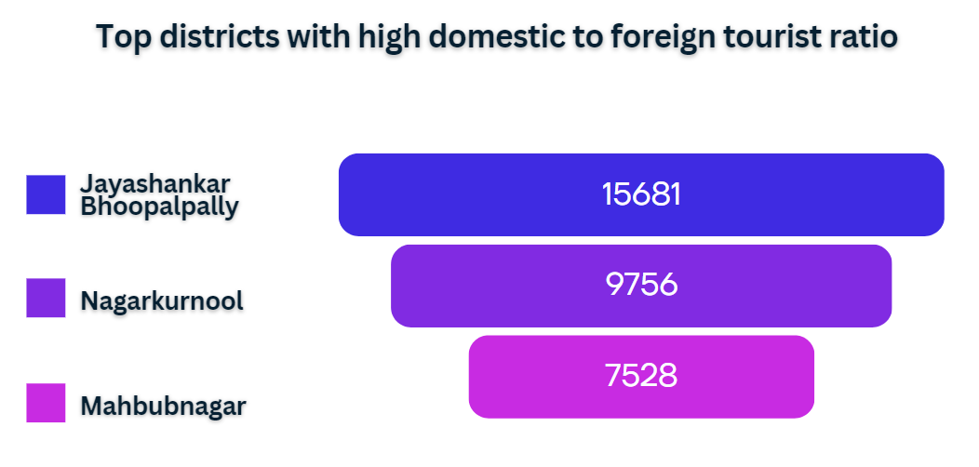
Top & bottom 3 districts with high domestic to foreign tourist ratio
Hyderabad has 80 domestic visitors for every 1 foreign tourist.
Districts with low domestic to foreign tourist ratios are best districts, as they have good foreign tourist.

Slide 7
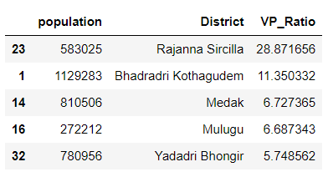
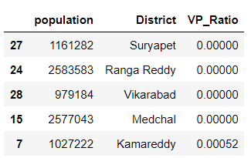
Top & bottom 5 districts based on tourist footfall ratio (2019)
Top 5 districts Bottom 5 districts
Based on the footfall ratio, Rajanna Sircilla emerges as the most popular tourist district relative to its population.
Suryapet district has several natural attractions such as the Nagarjuna Sagar Dam, Jatara at Peddagattu Lingamantula Swamy temple, Suryapet Venkateshwara Swamy Temple, Dargahs at Janpahad, Arvapally attractions of the district.
Suryapet district can also promote adventure tourism with activities such as trekking, rock climbing, and camping.

Slide 8
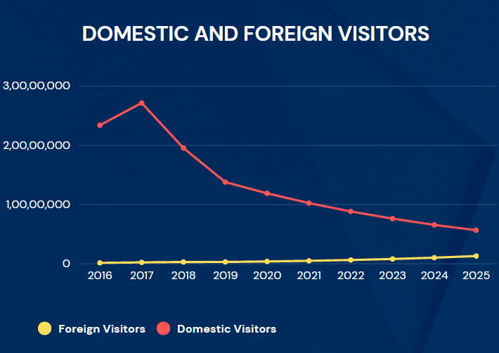
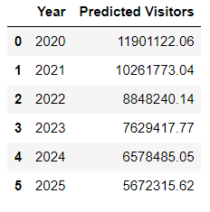
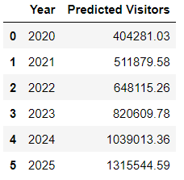
Projected number of domestic & foreign visitors in Hyderabad in 2025
Domestic Visitors
Foreign Visitors
According to the data, Domestic visitors can be decreased and foreign visitors can be increased.
Predicted Domestic visitors (2025) → 5.6M
Predicted Foreign visitors (2025) → 1.31M

Slide 9
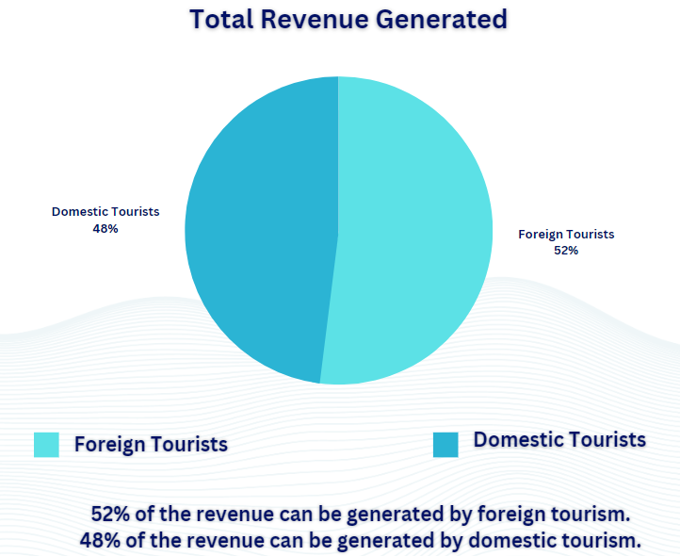
Projected revenue for Hyderabad in 2025
According to the data, “14.17 billion” revenue can be generated from Hyderabad tourism in 2025.
Predicted Domestic Revenue (2025)
→ 6.80B
Predicted Foreign visitors (2025)
→ 7.36 B
Predicted Total Revenue (2025)
→ 14.17B

Slide 10
Districts with highest potential for tourism growth
District | Tourist destinations | Actions to promote tourism
Hyderabad | Charminar, Golconda Fort, and Salar Jung Museum. | Improving its infrastructure, tourist-friendly policies, and organizing cultural events.
Warangal | Warangal Fort and Thousand Pillar Temple | Promoting local handicrafts and cuisine, investing in its infrastructure and organizing cultural festivals.
Nizamabad | Nizamabad Fort and Nizamabad Museum | Tourism-friendly policies, developing local handicrafts and cuisine and improving the city's infrastructure.
Karimnagar | Elgandal Fort and Kondagattu Anjaneya Swamy Temple | promoting local handicrafts and cuisine, and organizing cultural festivals.

Slide 11
Events to boost Telangana Tourism
x
Event | District | Months
Telangana Food Festival | Hyderabad and Warangal | January - February
Bathukamma Festival | Karimnagar, Nizamabad and Siddipet | September - October
Bonalu Festival | Hyderabad and Secunderabad | July - August
Telangana Folk Art and Music Festival | Adilabad, Khammam and Mahabubnagar | November - December
Telangana Investors Summit | Hyderabad | February - March
Telangana IT Conference | Hyderabad | June - July
Telangana Pharma and Healthcare Summit | Hyderabad | October - November

Slide 12
Hyderabad’s potential to emulate Dubai’s business model
Hyderabad require a concerted effort from all stakeholders, including the government, businesses, and the community, to work towards this goal.
Focus on factors such as location, business-friendly policies, infrastructure, skilled workforce, and branding.
Developing more IT Hub and Industrial Parks.
Focus on building better infrastructure, such as expanding its airport, improving its road and rail networks, and investing in public transportation.

Slide 13
Factors that can boost Telangana tourism, particularly Hyderabad
Promote Hyderabad's rich history
Focus on the city's culinary scene
Develop the city's infrastructure
Collaborate with travel agencies
Promote adventure tourism
Leverage social media
Partner with private players
Develop niche tourism
Health and Security

Slide 14
Steps to increase tourism in Telangana
Heritage Walks
Promotion of Festivals
Development of Tourist Spots
Promotion of Adventure Sports
Tourist Information Centres
Incentives for Tour Operators
Focus on sustainable tourism
Market the unique culture and heritage of Telangana

Slide 15


